Slide 1
Schrodinger’s Equation simulation
Zeinab sadeghian

Slide 2
outline
Time-dependent Schrodinger equation
Gaussian wave packets
FDTD algorithm
Free particle
Potentials
Step
Barrier
Finite hole

Slide 3
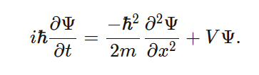
Time-dependent Schrodinger equation

Slide 4
outline
Time-dependent Schrodinger equation
Gaussian wave packets
FDTD algorithm
Free particle
Potentials
Step
Barrier
Finite hole

Slide 5
Gaussian wave packets
What does wave packet mean?
Gaussian wave packets

Slide 6
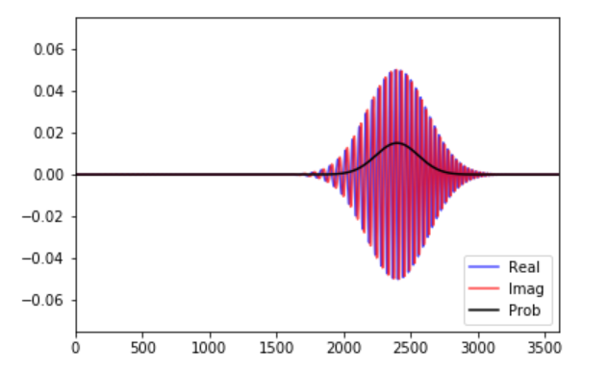
Gaussian wave packets
What does wave packet mean?
Gaussian wave packets

Slide 7

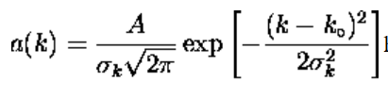

Gaussian wave packets
What does wave packet mean?
Gaussian wave packets

Slide 8
outline
Time-dependent Schrodinger equation
Gaussian wave packets
FDTD algorithm
Free particle
Potentials
Step
Barrier
Finite hole

Slide 9

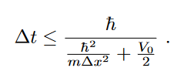
FDTD
ψ(x,t) =ψR(x,t) +jψI(x,t)

Slide 10
outline
Time-dependent Schrodinger equation
Gaussian wave packets
FDTD algorithm
Free particle
Potentials
Step
Barrier
Finite hole

Slide 11
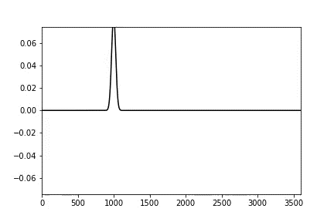
Free particle
Simulation
Why ?

Slide 12
Free particle
Simulation
Why ?

Slide 13
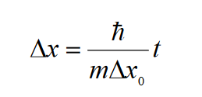

Free particle
Simulation
Why ?

Slide 14
Free particle
Simulation
Why ?

Slide 15
outline
Time-dependent Schrodinger equation
Gaussian wave packets
FDTD algorithm
Free particle
Potentials
Step
Barrier
Finite hole

Slide 16
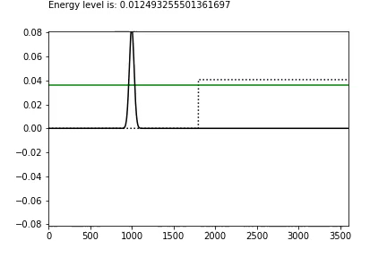
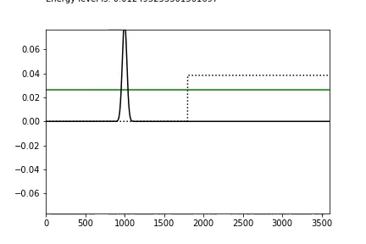
STep

Slide 17
outline
Time-dependent Schrodinger equation
Gaussian wave packets
FDTD algorithm
Free particle
Potentials
Step
Barrier
Finite hole

Slide 18
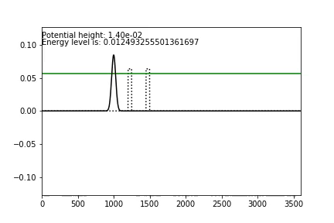
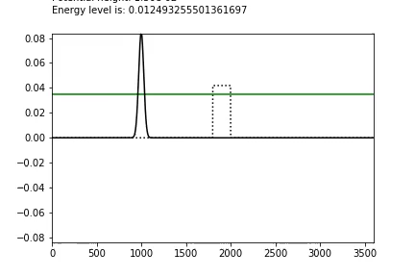
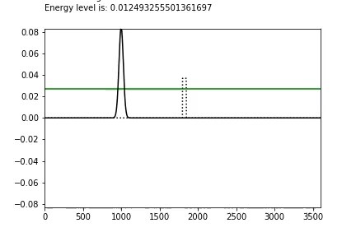
Barrier

Slide 19
outline
Time-dependent Schrodinger equation
Gaussian wave packets
FDTD algorithm
Free particle
Potentials
Step
Barrier
Finite hole

Slide 20
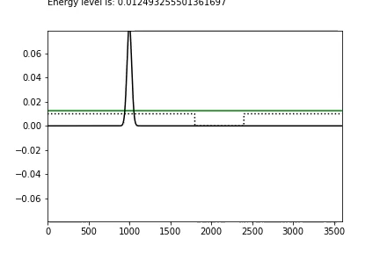
HOLE

